Slide 1
A look into salaries and statistics in the NBA
By: Bryan Mangrum, Charles Phil, Coye Roseberry and Shawn Varghese

Slide 2
What is the data we’re diving into?
One story we wanted to tell was on the correlation between how much a team spends on their players and their wins.
Does spending more on talent translate into wins?
The data set we used for the analysis was a SQLITE file of data pulled from the NBA API.
The original data in the file was extremely extensive (over 800MB!) so we had to clean quite a bit for the data to fit within our scope.

Slide 3
Our data’s transformation
After cleaning the enormous SQLITE file with SQL, we were able to narrow the data in the file to just what we needed and export those tables into separate CSVs.
We then imported the tables into Postgres and continued augmenting our data by pulling in other data sources.
Next, we created a Flask server in order to call the data for our visualizations from Postgres.
Finally, we developed the front end visualizations of our transformed data.

Slide 4

Mapping it all together
For the first part of our story, we show all the teams of the teams in the league and their arenas.
  This shows the user the location, the sponsor, their industry, and a link to the stadium.

Slide 5
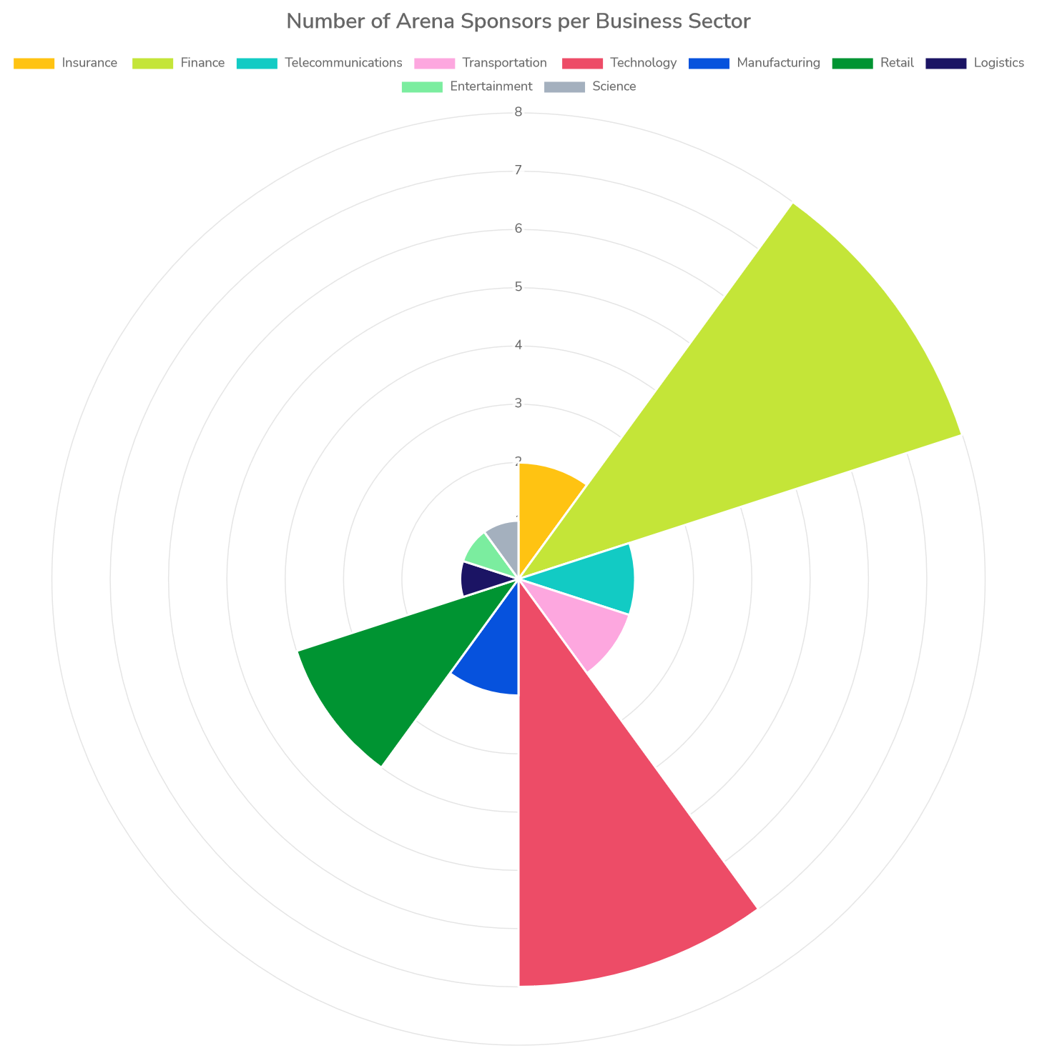
Sponsorship money
We also looked at money coming from sponsorships and the sectors of industry that are involved by looking at the arena sponsors for each team and breaking them into different business sectors.

Slide 6
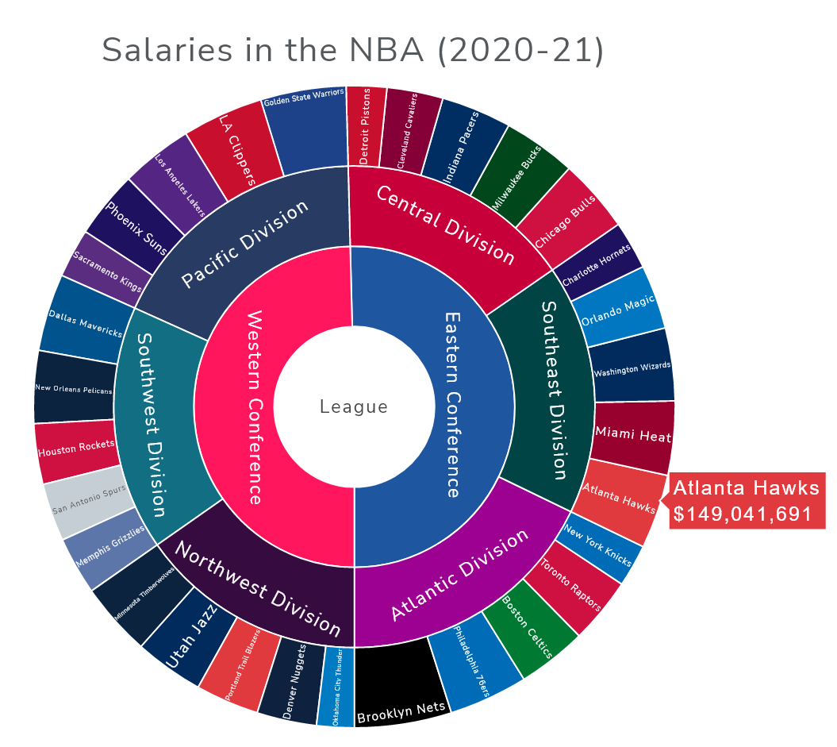
The Salary page
The next stop in our story is the total that teams spend on the salaries of players.
We start in the center with a breakdown between conferences and get more granular towards the outside where all the players reside.

Slide 7
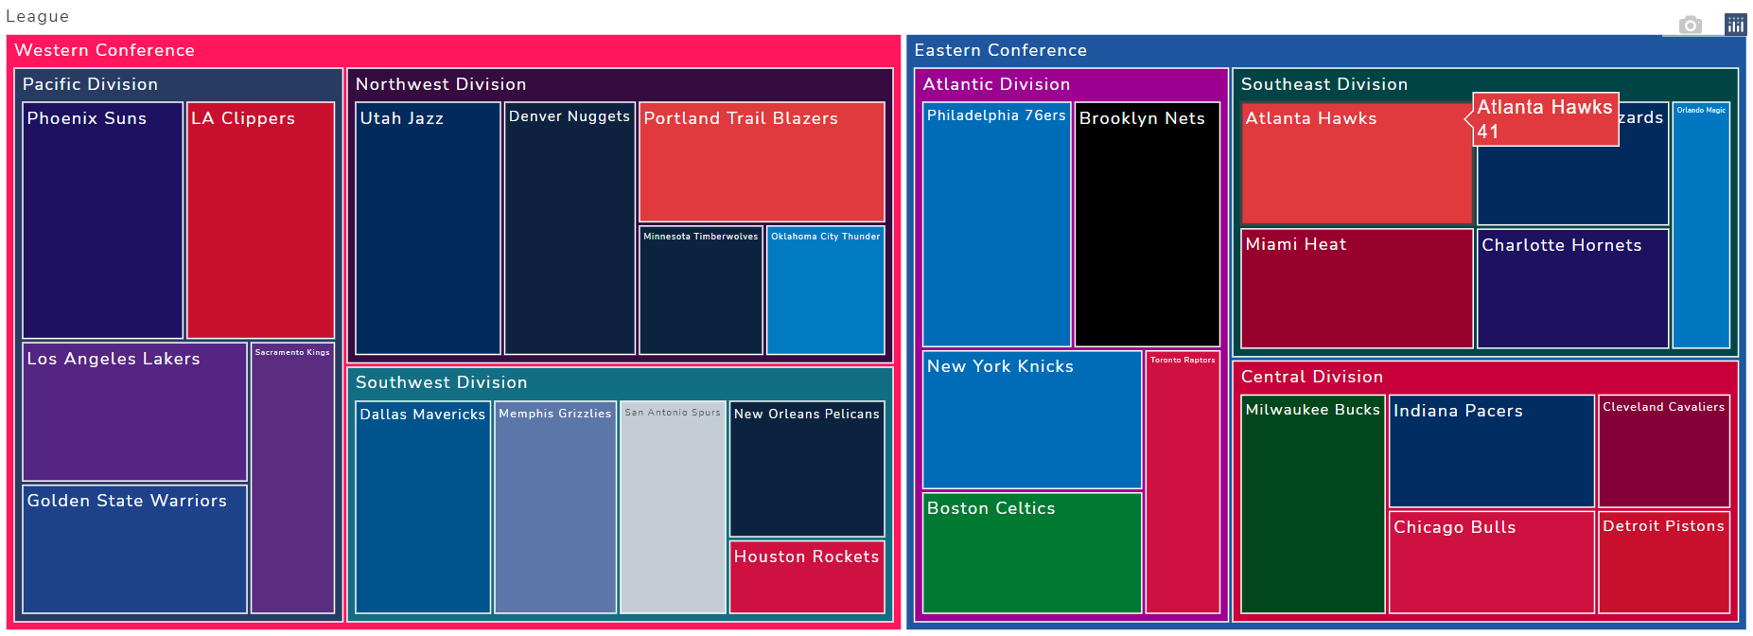
Total wins
On this page we take a dive into the wins grouped by conference, divisions, and then teams.
We want the user to be able to see the wins a team makes and then compare it to how much a team spends on their players.

Slide 8
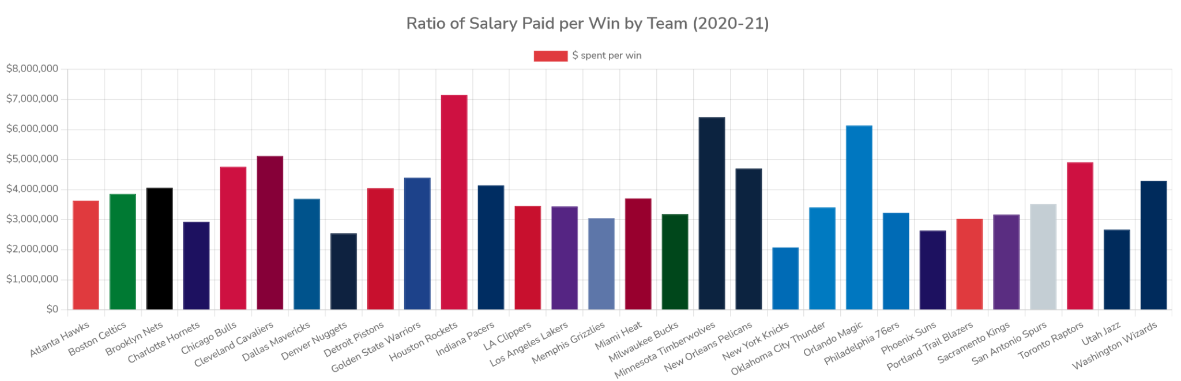
How much did each win cost?
The next table shows the user how much each win cost by dividing the combined salaries for the season for each team by the number of wins for each team.
The user can see for themselves: did the team over or under pay for player talent when using wins as a metric?

Slide 9
Questions?

